Slide 1

RIDE PAL
Troy Stefano, Sowmya Kommireddy, Bader Alonazi

Slide 2
Ride Pal
What is Ride Pal?
Ride Pal is a ridesharing/carpooling app that allows students of Saint Joseph University to connect with each other and carpool to class.
Who Would Use Ride Pal?
The main demographic of this app would be for people who live in Manayunk or other off campus housing.
What Makes Ride Pal Different?
Unlike traditional ridesharing apps like Uber, Ride Pal is set up like a forum where users can create ride listings and other users can apply to be their Ride Pal. Also the rides are automatically recurring until one party decides to delete the ride from their ride list.
Why Use Ride Pal?
Ride Pal will help you save on gas, reduce the struggle of finding parking on campus, and it will help you meet new friends.

Slide 3

About the App
Operating system
Android
Development Environment
Android Studio
Language
Java
Database
Firebase
Real Time Database
Authenticator
Storage

Slide 4
Some Features…
Sophisticated Firebase Sign in process
Creating a Ride
Applying For Rides
Google maps API to find an Address
App assisted messaging
App assisted Directions
Profile editor

Slide 5
Creating an Account

Slide 6


Slide 7
Creating Rides

Slide 9
Applying For Rides

Slide 10
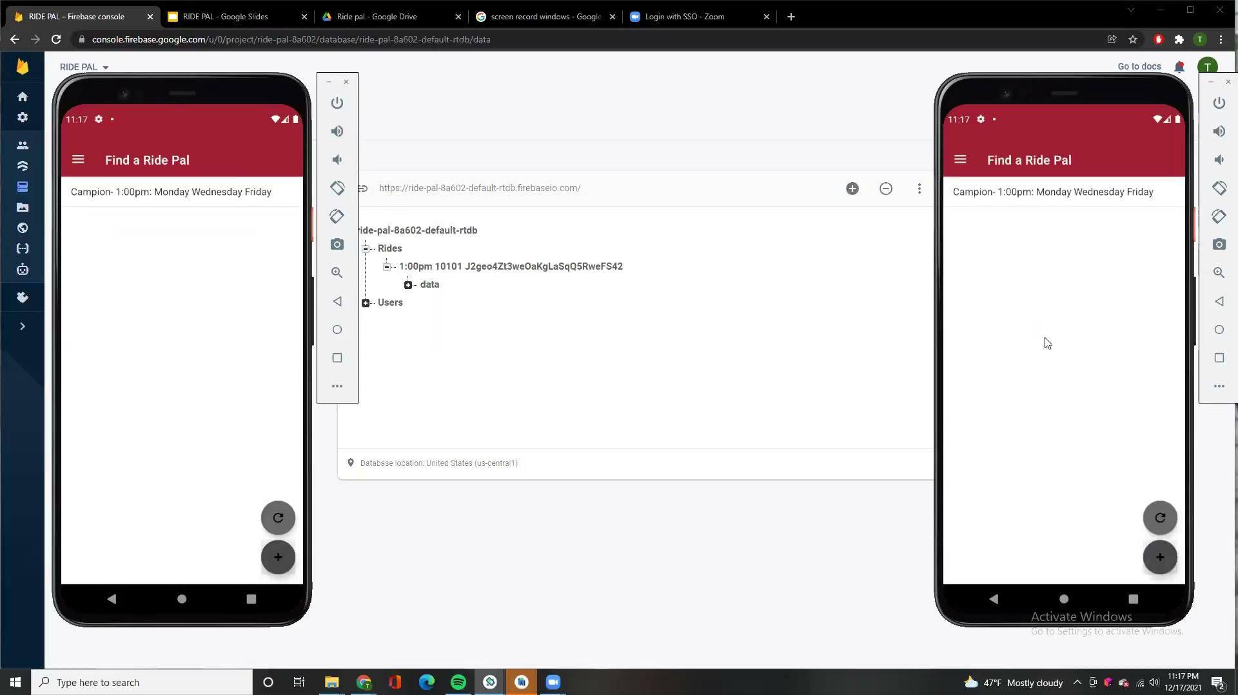

Slide 11
Interacting With Your Rides

Slide 12
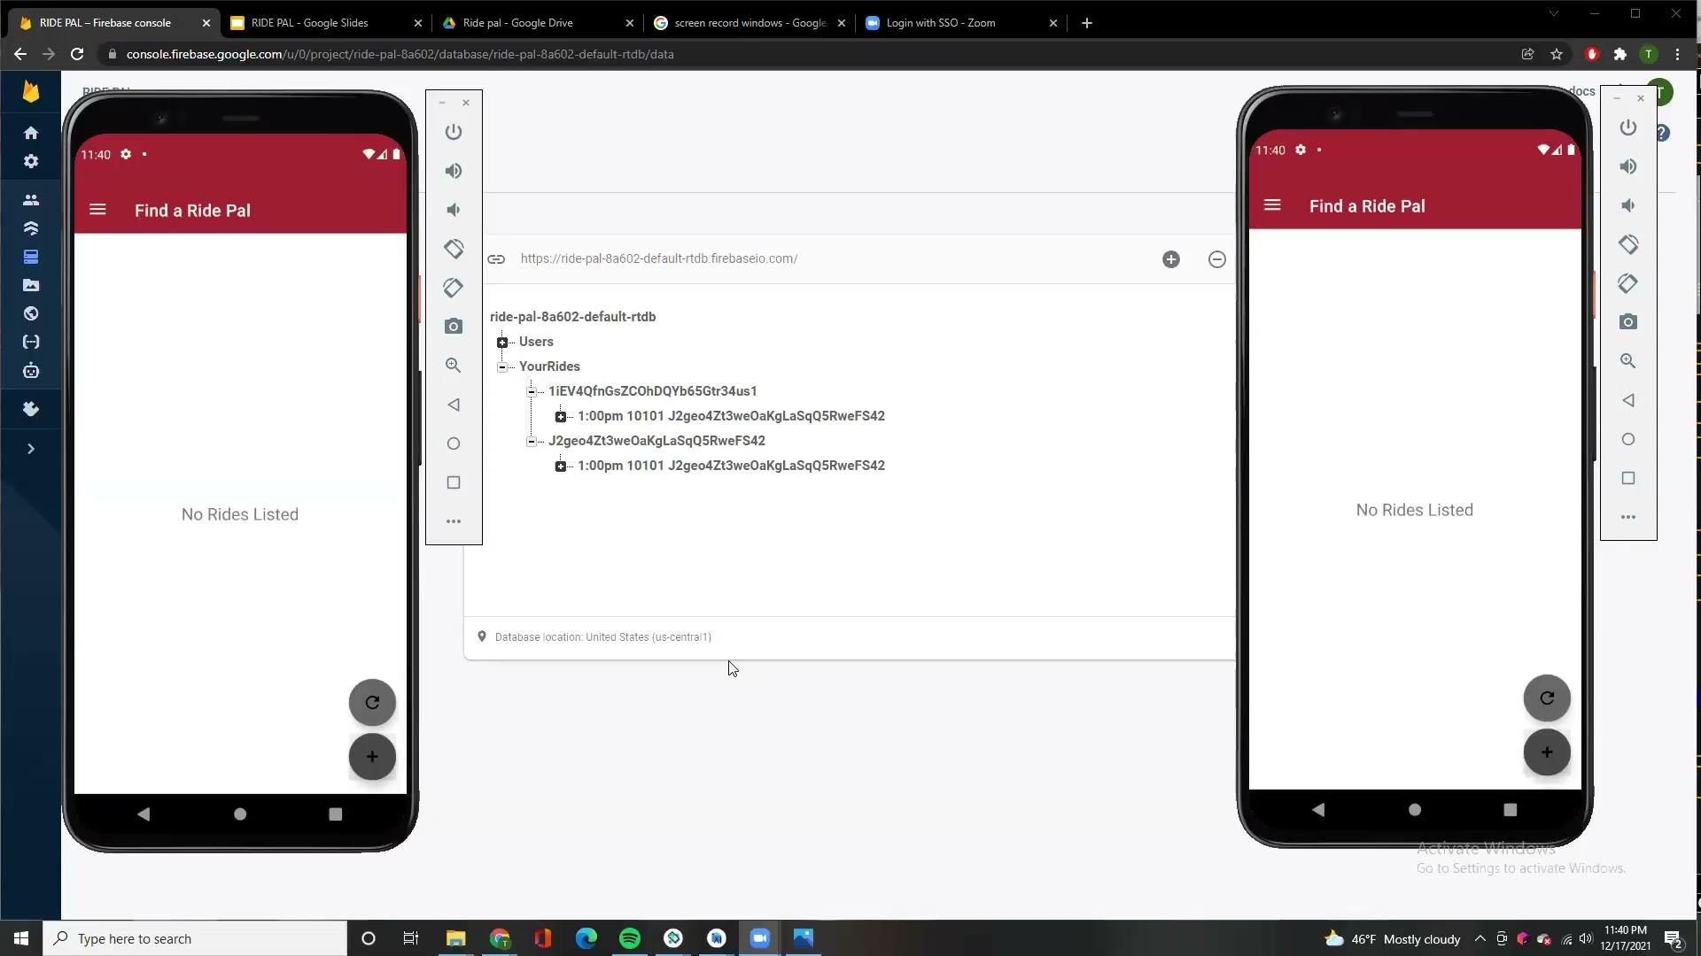

Slide 13
Editing Profile

Slide 14
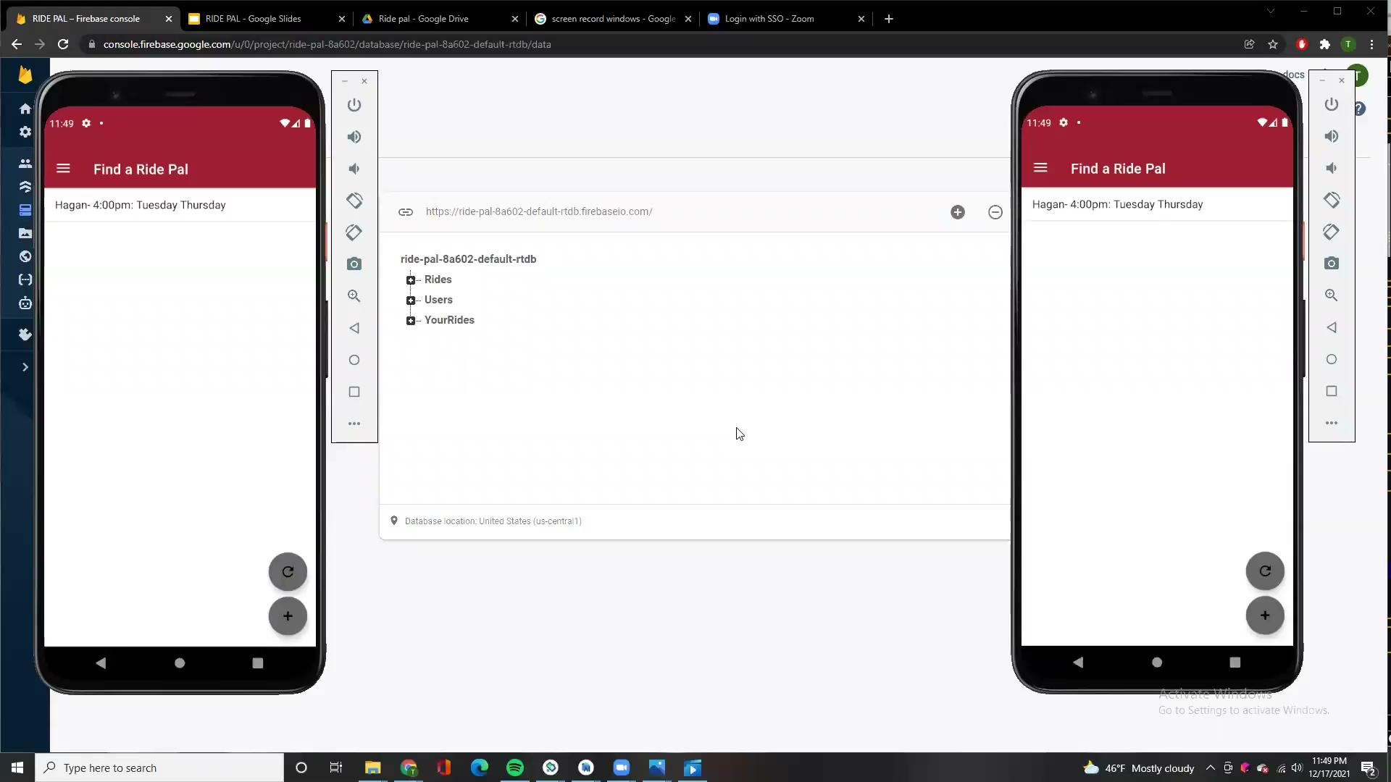

Slide 15
The Code
https://github.com/tstef87/RIDE-PAL.git

